Slide 1
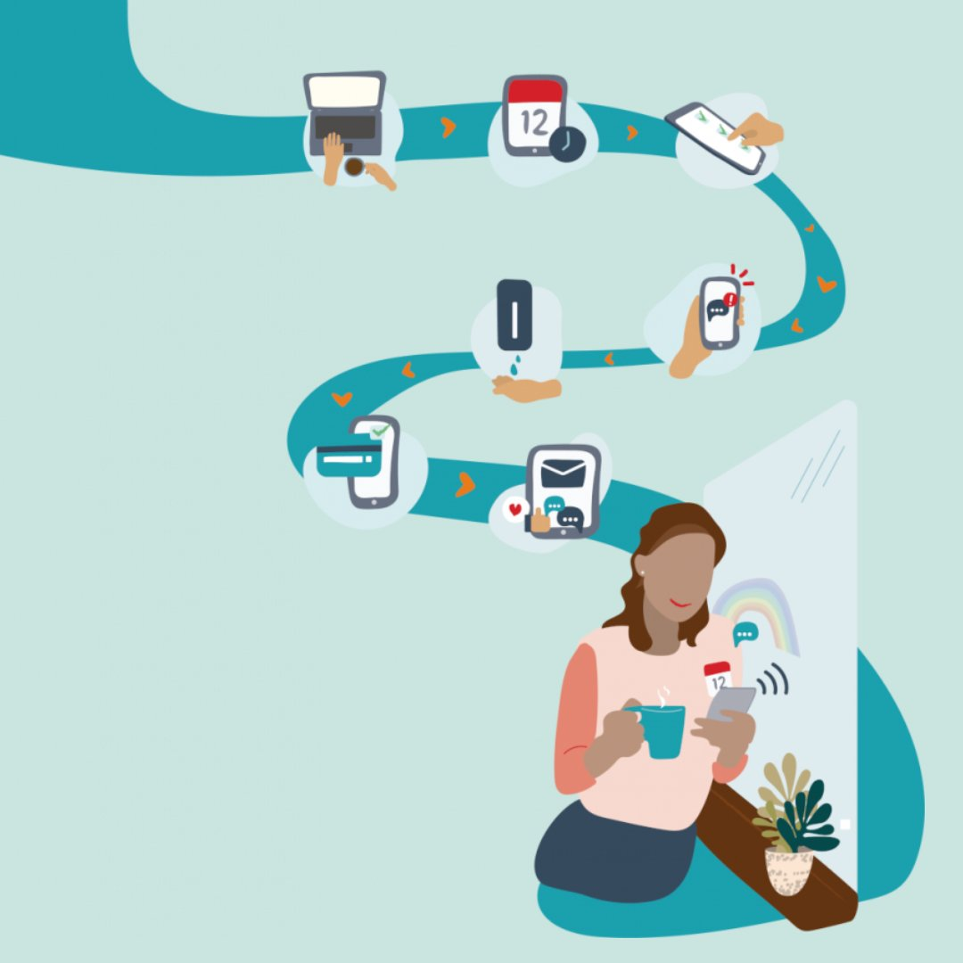
Campaign+ Information Pack (Please play as slideshow)

Slide 2
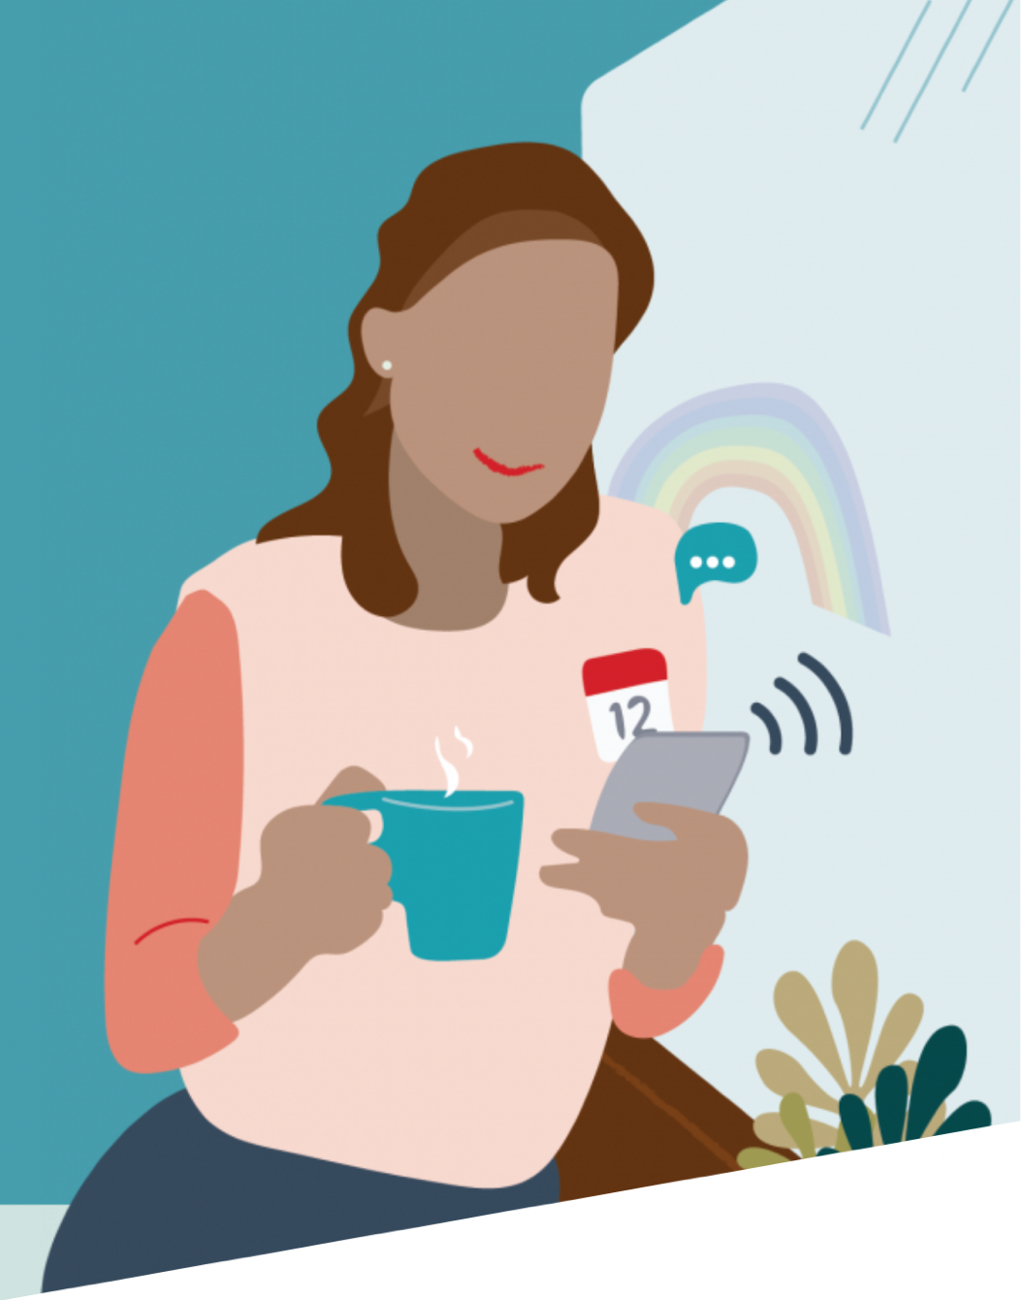
Agenda
Welcome to Campaign Plus
What Campaigns can we send
Best Practice Campaigns
We can also help with…
Dental Awareness Days
Step by step guides for Campaign set ups
Other Help Guides

Slide 3
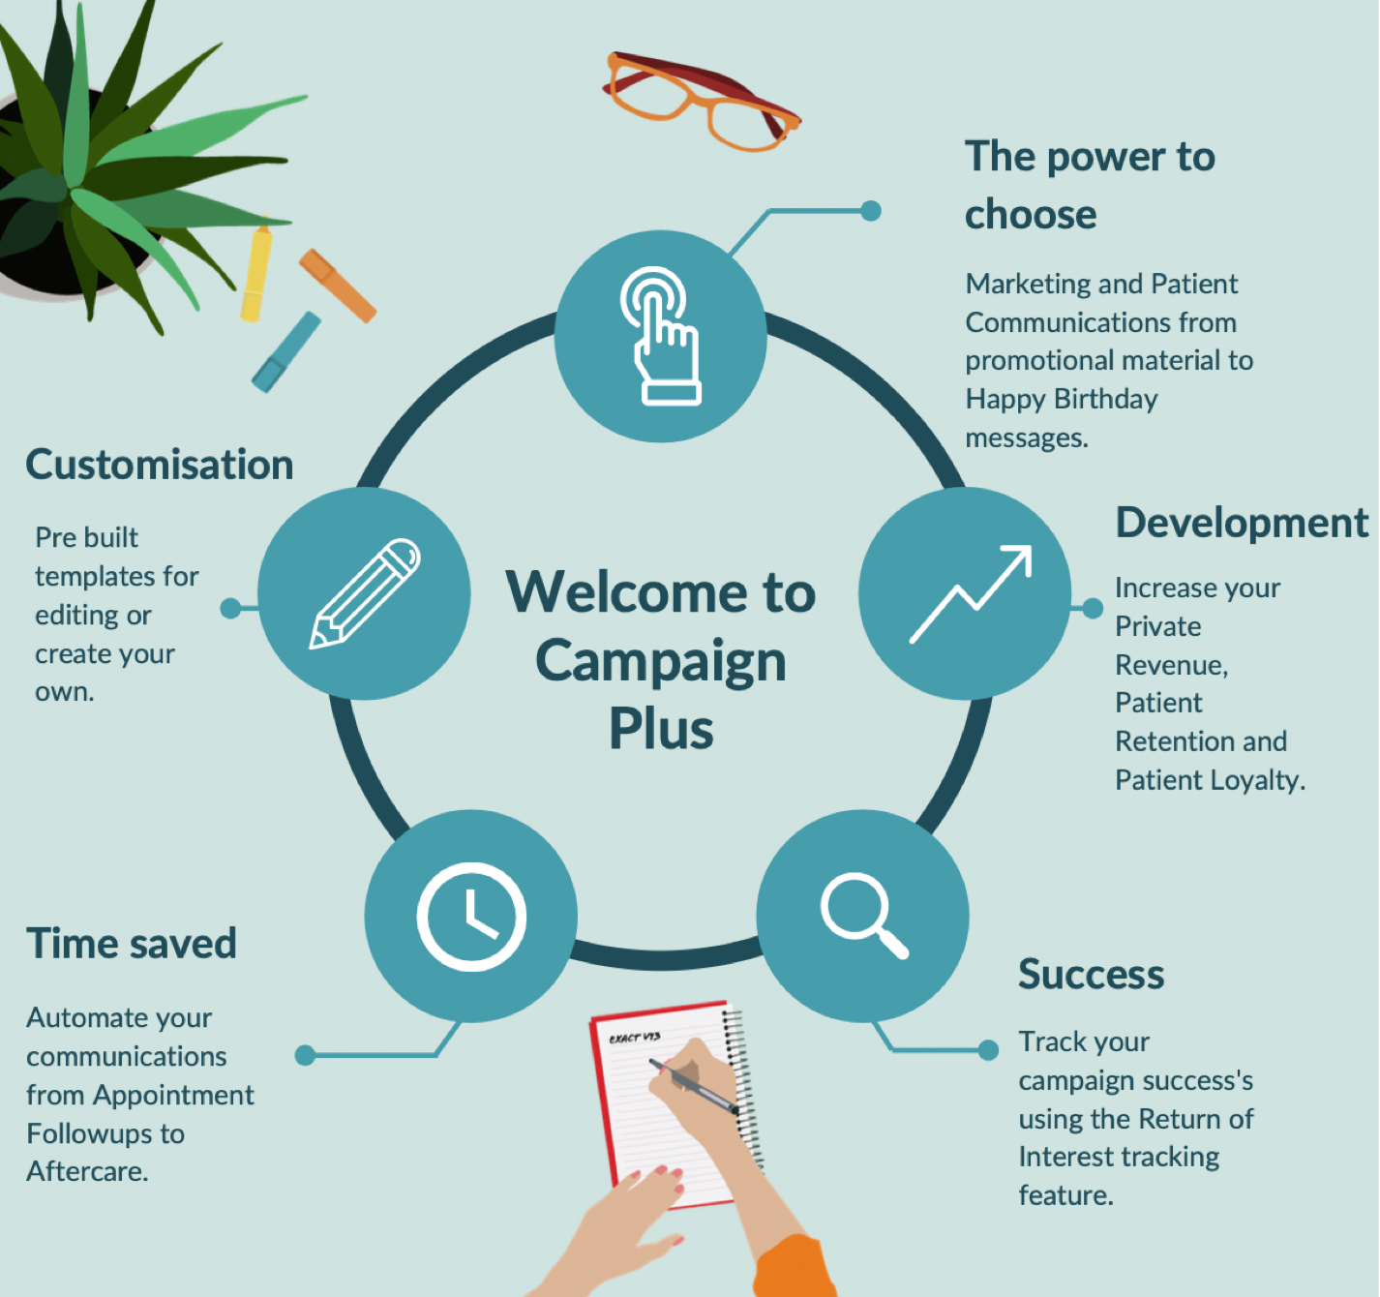
Let us help you start your Campaign Plus journey...
What can you achieve?
Important: If you change your practice email, please update SOE.
Failing to do this may result in your campaigns failing to send.

Slide 4
What Campaigns Can We Send?
Informative Changes at the practice
Educational
Looking after
Oral Health
Marketing Promo/Offers
One-Off Campaigns
These are the campaigns that have a start and end date, sending out once to a selected group of patients.
Examples of a One-Off Campaign:
Open Days
Practice Newsletters
Monthly Offers
Continuous Campaigns (Set & Forget)
These are the campaigns that are automated and can be left to run in the background. They will continue to look for patients who fit the criteria of the contact list.
Examples of continuous campaigns:
Happy Birthdays
Pre-op and Post-op care
Promoting hygiene services following a routine check up
New patient welcome

Slide 5
Not Sure Where To Start?
We've created a group of campaigns that we like to call our 'Best Practice' campaigns.
These are the campaigns that cover a wide range of treatments and services.
They use a range of mixed media and target the patients who are most likely to book in for treatment.
With a mix of GDPR compliant and promotional campaigns, we have all bases covered:
Hygiene, Examinations, Implants, Bridge & Dentures, Whitening, Invisalign/Orthodontics,
Facial Aesthetics, New patients, Lapsed patients & Oral Health Survey Follow-ups.
Click below for our examples.
Best Practice Campaigns
Lost for ideas?
We have a range of pre-built templates ready to use.
They are guides to help you create campaigns quicker and easier. You can customise them to fit your brand and practice needs.
Important: If you change your practice email, please update SOE.
Failing to do this may result in your campaigns failing to send.

Slide 6
We can also help with….
Reminders
Reduce your patients' no-shows with automated reminder letters. (Ensure you are not missing patients who do not have a mobile or email address in the system)
FTA’s
Educate patients by sending automated letters to patients who have FTA’d their appointment.
Explain the importance of following the practice FTA policy and start introducing charges or de-registrations to repeat offenders.
Debt
Contact those patients with outstanding invoices by sending automated Debt letters.
1st letter – Informing the patient of the unpaid invoice
2nd letter – Asking the patient to pay the unpaid invoice
3rd letter – sending a final reminder.

Slide 7
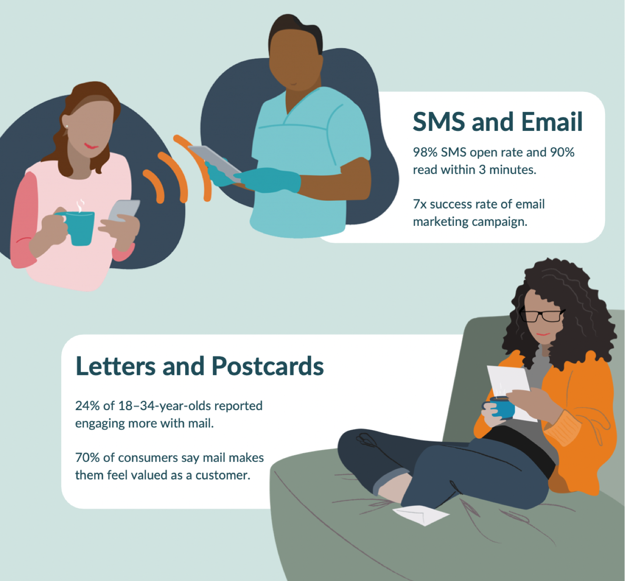
Media Types
We can send the following
type of media using Campaign+

Slide 8
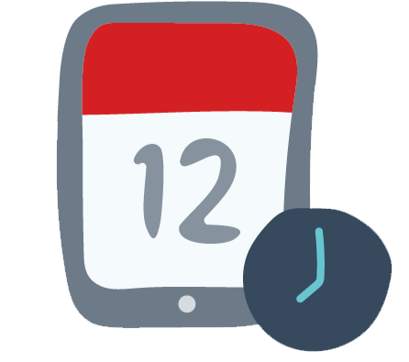
Save The Dates for Dental Awareness
February
Children’s Dental Health Month
Gum Disease Awareness Month
Toothache Day
March
No Smoking Day
April
Oral Health Month
May
Root Canal Awareness Week
June
Dental Smiles Month
National Teeth Whitening Day
August
Tooth Fairy Day
September
Gum Care Month
National Toothache Day
October
Dental Hygiene Month
World Smile Day
November
Mouth Cancer Awareness Month
National Brush Your Teeth Day
Sugar Awareness Week

Slide 9
Set up your Campaign
(Click to download the step-by-step guides)
General Marketing
(Open Days, Promos etc)
New Patient Welcome
Exam To Hygiene
Oral Health Survey
Facial Aesthetics
General Newsletters
Reactivation Letter
(lapsed patients)
Hygiene to Whitening
Oral Health Survey
(Straightening)
Happy Birthday
Pre-Extraction
Reactivation email
(lapsed patients)
Oral Health Survey
(Whitening)
Happy Birthday
(with offer/discount)
Extraction Aftercare
Google Review
Oral Health Survey
(Implants)
Extraction to Options
Invisalign Consult to Treatment

Slide 10
Click Here for other Help Guides
Important: If you change your practice email, please update SOE.
Failing to do this may result in your campaigns failing to send.

